Slide 1
Data Analysis using Python
By Aparna Padmakumar

Slide 2
A production company wants to analyze a movie dataset to identify what kind of movies perform well in cinemas, which genres they belong to and so on. It will help the company predict if a movie will be a commercial success, if the movie will be highly rated etc.

Slide 3
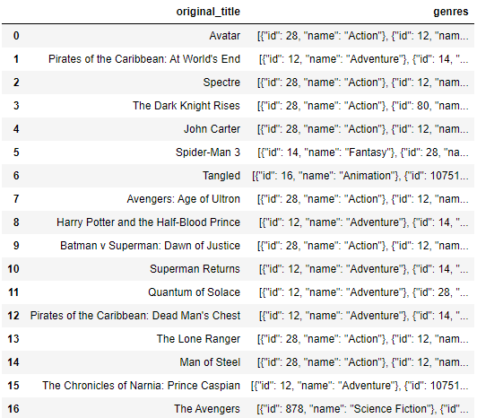

Task 1: Load the movie dataset in python notebook. Display the numbers of rows and columns in the dataset. Display the titles and genres of the first 50 movies from the dataset
Used shape function to display the rows and columns in the dataset.

Slide 4
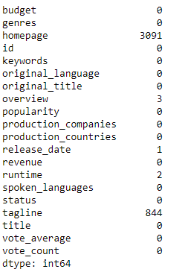
Task 2: Identify the columns that have null values and perform the null value treatment.
isnull().sum() function helped to find out number of missing values
For treating missing values I imputed the mode values in the missing value

Slide 5
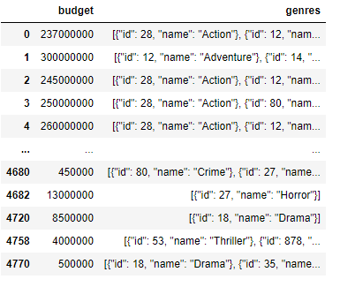
Task 3: Display the movie category that have budget greater than 220000
By filtering the budget column I got the desired output.

Slide 6
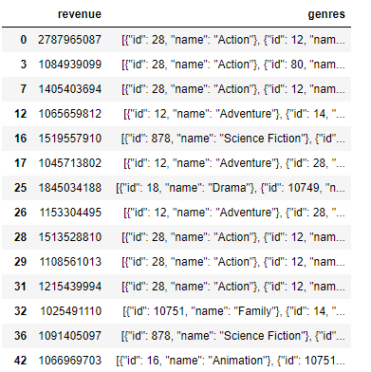
Task 4: Display the movie categories were the revenue is greater than 961,000,000
This output shows the movie categories were the revenue is greater than 961,000,000.

Slide 7
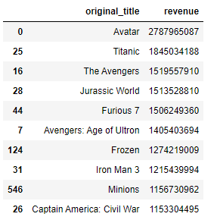
Task 6: Top 10 movies with the highest revenue
These are the top 10 movies sorted by revenue in descending order.

Slide 8
Task 7: How are Popularities of movies related with the movie budgets? Are they correlated or totally uncorrelated with each other? Write the interpretation of your analysis
Correlation coefficient between popularity and budget: 0.43199013600797537
The analysis indicates that there is a moderate positive correlation between movie budget and popularity which indicates that higher budget movies tend to have higher popularity

Slide 9
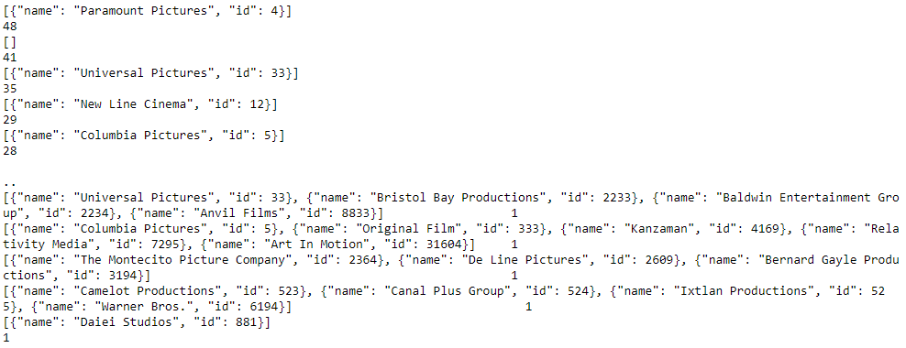
Task 8: Find out Production companies and their counts
By using value_counts() I got the count of production companies.

Slide 10
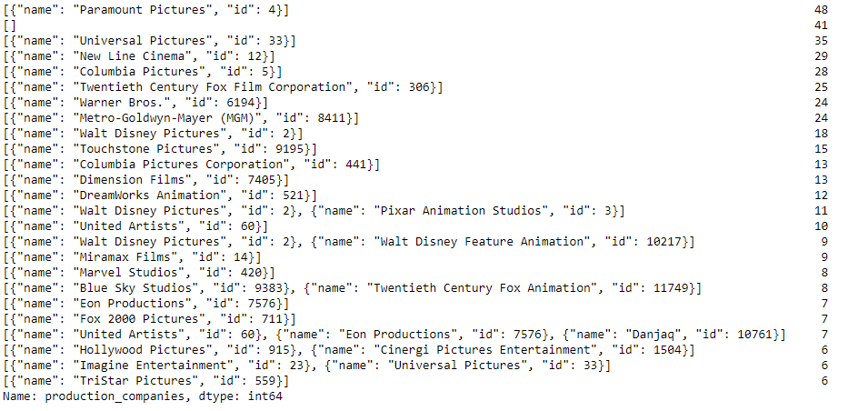
Task 9: Top 25 production companies in descending order based on value counts

Slide 11



Task 10: Find out the central tendencies of budget, revenue and runtime

Slide 12
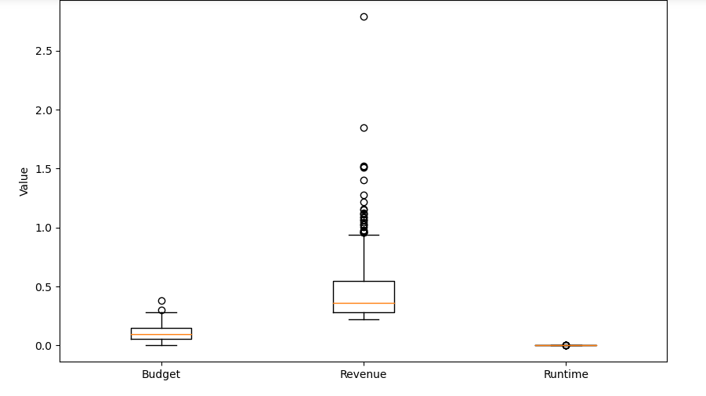
Outlier analysis using box plot

Slide 13
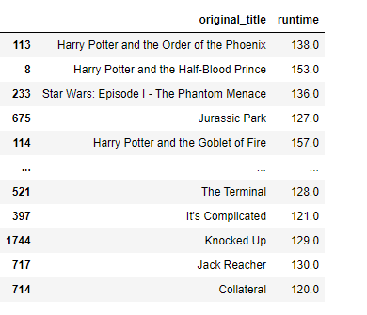
Task 11: Find out movies above average run time
This are the top 10 movies with above average runtime

Slide 14
CONCLUSION
The movie dataset analysis reveals key insights into the film industry, including top production companies, highest revenue-generating and lowest-budget movies.
The analysis also uncovers the correlation between movie popularity and budget.
The analysis provides important information based on data to help people in the movie industry make better decisions.

Slide 15
THANKYOU

